Slide 1
Chapter 4: The Efficiency of Algorithms
Manar Mohamed
mohamem@miamioh.edu

Slide 2
This week:
No project!
Resubmit Homework 1 by Sunday if you want
Do Leetcode problems instead
Set up an account
Start solving problems
Problems 237 and 83 are good starting problems

Slide 3
Complexity in computer science
Some problems are more complex than others
What do we mean by complexity?
Examples
How do we measure it?
Notation
Getting formal

Slide 4
Time and space
Time: How long it takes to do something
Space: How much memory usage is needed

Slide 5
Efficiency of algorithms:
We are often concerned with which of two algorithms is more efficient:
Linear search vs. Binary search
Finding the nth element in an array? Or finding the nth element in a linked list?

Slide 6
Measuring complexity…
Learn to ask the question, “What kind of function does this remind me of?”
This is precalculus…which studies families of functions.

Slide 7
Important function families:
Constant
Linear
Polynomial
Logarithmic
Exponential
Factorial

Slide 8
Things to know about these functions:
What is the basic shape of each graph?
How fast does each graph grow?

Slide 9
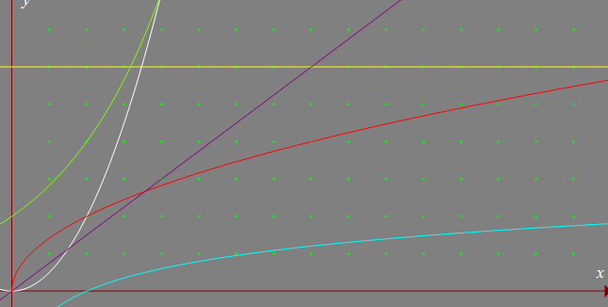
Do you recognize these functions?
Which color is…
constant?
linear?
polynomial?
exponential?
logarithmic?
square root?

Slide 10
Do you recognize these functions?
Which color is…
constant?
linear?
polynomial?
exponential?
logarithmic?
square root?
constant
X^2
x
sqrt x
2^x
log x

Slide 11
Example:
Searching a fixed-array bag to see if it contains a particular object…
The basic operation here is "comparison"
How many comparisons…
In the best case?
In the worst case?
On average?

Slide 12
How does that notation work?
It is not a formula.
Rather, it shows the general shape of the complexity.

Slide 13
Can't we just run it and measure the time?
It's not that simple

Slide 14
Why Efficient Code?
Computers are faster, have larger memories
So why worry about efficient code?
And … how do we measure efficiency?

Slide 15

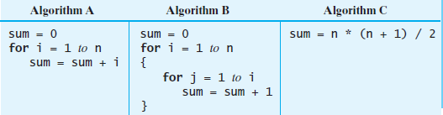
Example
Consider the problem of summing
FIGURE 4-1 Three algorithms for computing the sum 1 + 2 + . . . + n for an integer n > 0

Slide 16
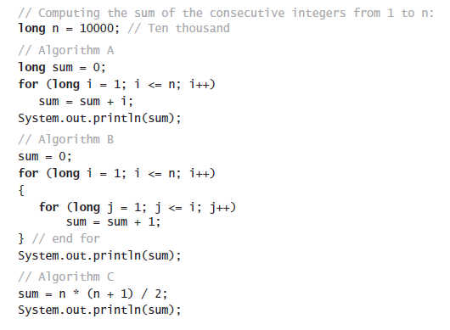
Example
Java code for the three algorithms

Slide 17
What is “best”?
An algorithm has both time and space constraints – that is complexity
Time complexity
Space complexity
This study is called analysis of algorithms

Slide 18
Counting Basic Operations
A basic operation of an algorithm
The most significant contributor to its total time requirement
 | Algorithm A | Algorithm B | Algorithm C
 | long sum = 0; for (long i = 1; i <= n; i++) sum = sum + i; | sum = 0; for (long i = 1; i <= n; i++) { for (long j = 1; j <= i; j++) sum = sum + 1; } // end for | sum = n * (n + 1) / 2;
Additons
Multiplications
Divisions
Total Basic Operations
FIGURE 4-2 The number of basic operations required by the algorithms in Figure 4-1

Slide 19
Counting Basic Operations
A basic operation of an algorithm
The most significant contributor to its total time requirement
 | Algorithm A | Algorithm B | Algorithm C
 | long sum = 0; for (long i = 1; i <= n; i++) sum = sum + i; | sum = 0; for (long i = 1; i <= n; i++) { for (long j = 1; j <= i; j++) sum = sum + 1; } // end for | sum = n * (n + 1) / 2;
Additons | n
Multiplications | 0
Divisions | 0
Total Basic Operations | n
FIGURE 4-2 The number of basic operations required by the algorithms in Figure 4-1

Slide 20
Counting Basic Operations
A basic operation of an algorithm
The most significant contributor to its total time requirement
 | Algorithm A | Algorithm B | Algorithm C
 | long sum = 0; for (long i = 1; i <= n; i++) sum = sum + i; | sum = 0; for (long i = 1; i <= n; i++) { for (long j = 1; j <= i; j++) sum = sum + 1; } // end for | sum = n * (n + 1) / 2;
Additons | n | n(n + 1)/2
Multiplications | 0 | 0
Divisions | 0 | 0
Total Basic Operations | n | (n² + n)/2
FIGURE 4-2 The number of basic operations required by the algorithms in Figure 4-1

Slide 21
Counting Basic Operations
A basic operation of an algorithm
The most significant contributor to its total time requirement
 | Algorithm A | Algorithm B | Algorithm C
 | long sum = 0; for (long i = 1; i <= n; i++) sum = sum + i; | sum = 0; for (long i = 1; i <= n; i++) { for (long j = 1; j <= i; j++) sum = sum + 1; } // end for | sum = n * (n + 1) / 2;
Additons | n | n(n + 1)/2 | 1
Multiplications | 0 | 0 | 1
Divisions | 0 | 0 | 1
Total Basic Operations | n | (n² + n)/2 | 3
FIGURE 4-2 The number of basic operations required by the algorithms in Figure 4-1

Slide 22
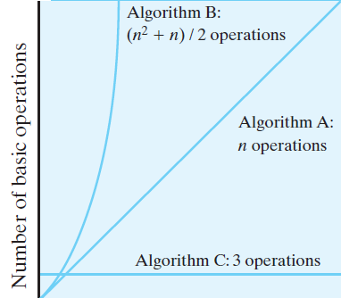
Counting Basic Operations
FIGURE 4-3 The number of basic operations required by the algorithms in Figure 4-1 as a function of n

Slide 23
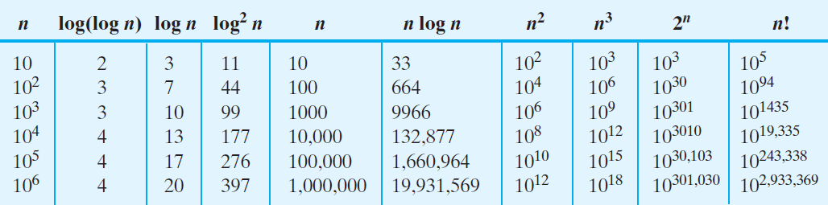
Counting Basic Operations
FIGURE 4-4 Typical growth-rate functions evaluated at increasing values of n

Slide 24
Best, Worst, and Average Cases
For some algorithms, execution time depends only on size of data set
Other algorithms depend on the nature of the data itself
Here we seek to know best case, worst case, average case

Slide 25
Big Oh Notation
A function f(n) is of order at most g(n)
That is, f(n) is O(g(n)) — if
A positive real number c and positive integer N exist …
Such that f(n) ≤ c.g(n) for all n ≥ N
That is:
c.g(n) is an upper bound on f(n) when n is sufficiently large

Slide 26
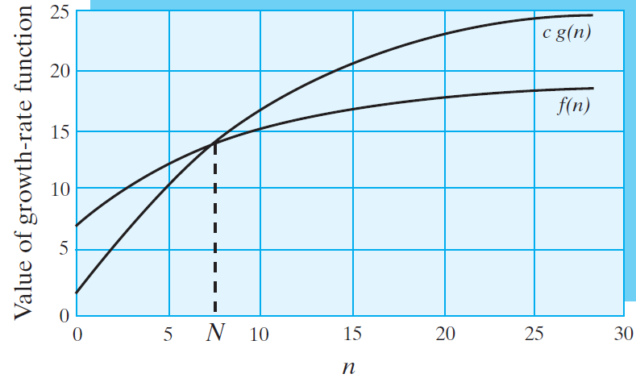
Big Oh Notation
FIGURE 4-5 An illustration of the definition of Big Oh

Slide 27
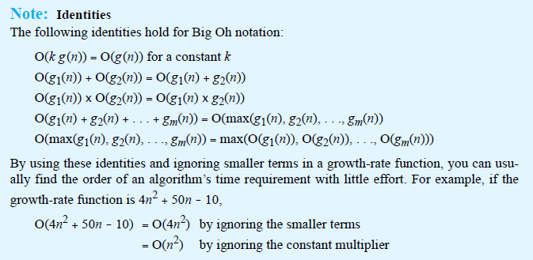
Big Oh Notation
Identities for Big Oh Notation

Slide 28
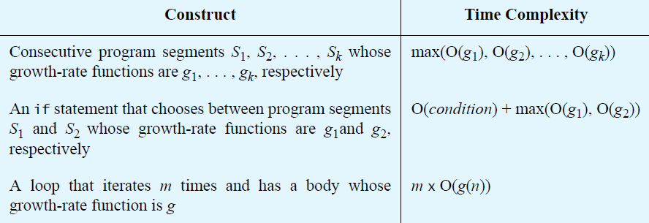
Complexities of Program Constructs

Slide 29
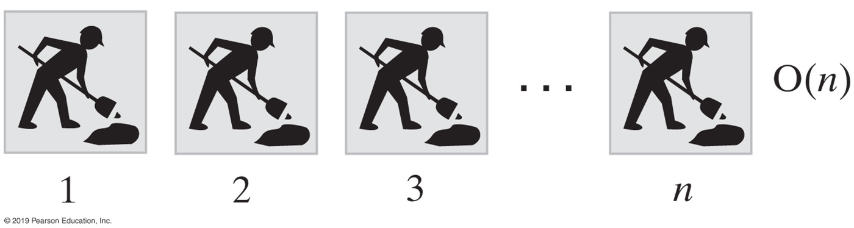
Picturing Efficiency
long sum = 0;
for (long i = 1; i <= n; i++)
sum = sum + i;
FIGURE 4-6 An O(n) algorithm

Slide 30
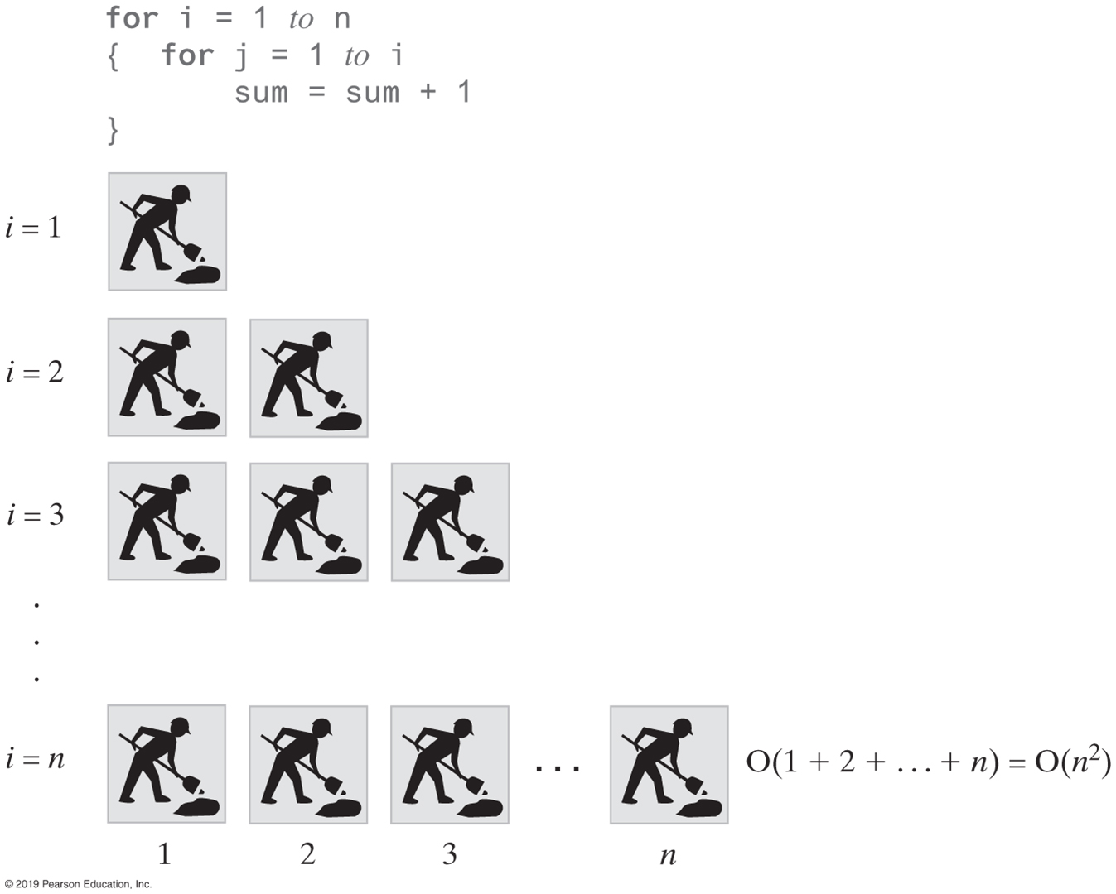
Picturing Efficiency
sum = 0;
for (long i = 1; i <= n; i++)
{
for (long j = 1; j <= i; j++)
sum = sum + 1;
} // end for
FIGURE 4-7 An O(n²) algorithm

Slide 31
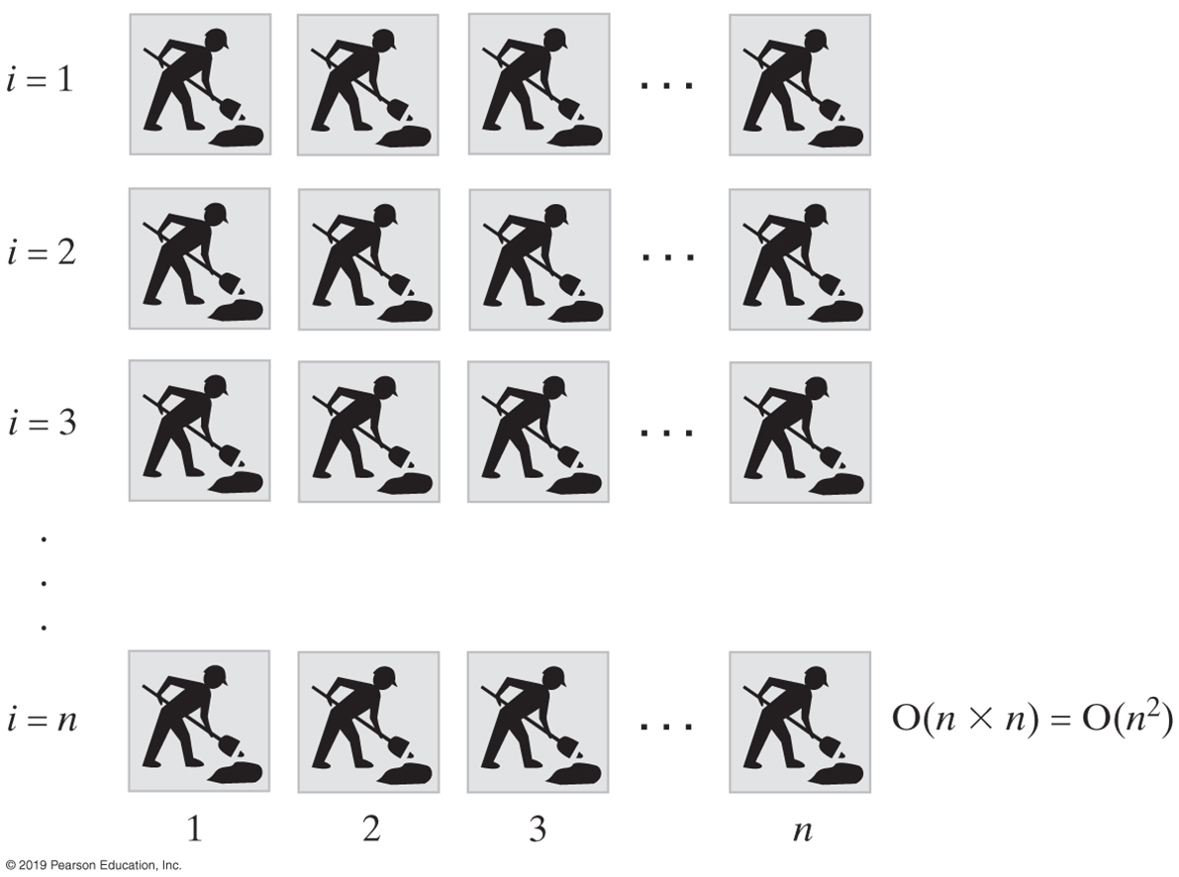
Picturing Efficiency
sum = 0;
for (long i = 1; i <= n; i++)
{
for (long j = 1; j <= n; j++)
sum = sum + 1;
} // end for
FIGURE 4-8 Another O(n²) algorithm

Slide 32
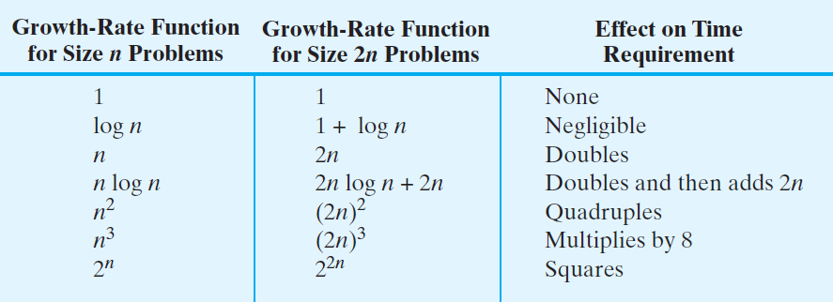
Picturing Efficiency
FIGURE 4-9 The effect of doubling the problem size on an algorithm’s time requirement

Slide 33
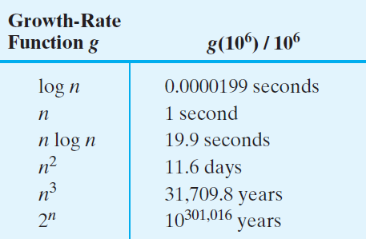
Picturing Efficiency
FIGURE 4-10 The time required to process one million items by algorithms of various orders at the rate of one million operations per second

Slide 34
Efficiency of Implementations of ADT Bag
Operation | Fixed-Size Array | Linked
add(newEntry)
remove()
remove(anEntry)
getFrequencyOf(anEntry)
contains(anEntry)
toArray()
getCurrentSize(), isEmpty()
FIGURE 4-11 The time efficiencies of the ADT bag operations for two implementations, expressed in Big Oh notation

Slide 35
Efficiency of Implementations of ADT Bag
Operation | Fixed-Size Array | Linked
add(newEntry) | O(1) | O(1)
remove() | O(1) | O(1)
remove(anEntry) | O(1), O(n), O(n) | O(1), O(n), O(n)
getFrequencyOf(anEntry) | O(n) | O(n)
contains(anEntry) | O(1), O(n), O(n) | O(1), O(n), O(n)
toArray() | O(n) | O(n)
getCurrentSize(), isEmpty() | O(1) | O(1)
FIGURE 4-11 The time efficiencies of the ADT bag operations for two implementations, expressed in Big Oh notation

Slide 36
Bubble Sort:
It took 3 minutes to sort 10 Hungarian dancers.
How long will it take to sort 50?
15 minutes
30 minutes
50 minutes
75 minutes
none of the above

Slide 37
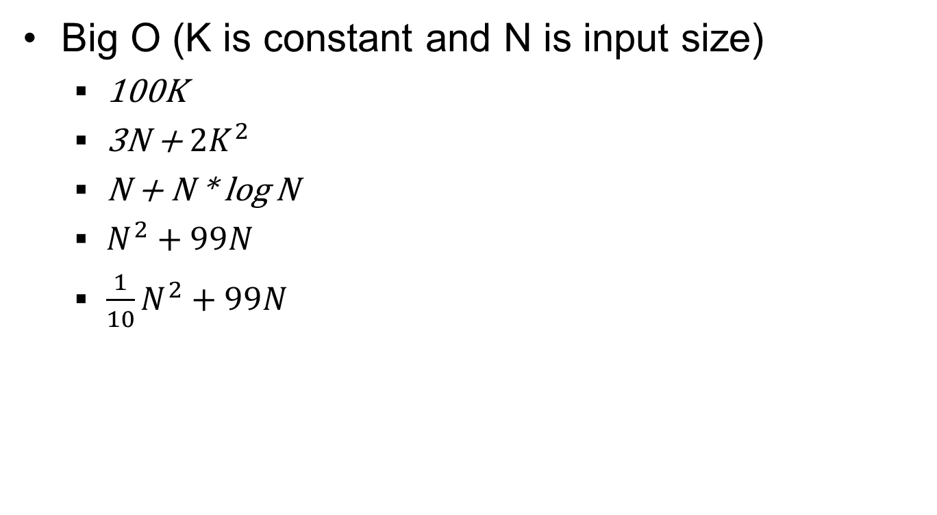

Slide 38
Big O
for (int i=0; i<N; i+=2) { ... }
for (int i=-100; i<100; i+=1) { ... }
for (int i=N-5; i<N+5; i+=1) { ... }
for (int i=0; i<N; i+=2) { ... }
for (int i=0; i<N; i+=2) { ... }

Slide 39
Big O
for (int i=0; i<N; i+=2)
for (int j=0; j<50; j+=1) { ... }
for (int i=0; i<N; i+=2)
for (int j=0; j<N; j+=1) { ... }
for (int i=0; i<N; i+=2)
for (int j=0; j<i; j+=1) { ... }

Slide 40
END

